Slide 1

Varendra University
Dept. of Computer Science & Engineering (CSE)
Introduction to IBM PC Assembly Language (Chapter-4)
Course Title: Microprocessor and Assembly Language
Course No: CSE 3205
Prepared By:
Md. Adnan Sami
Lecturer, Dept. of CSE, VU

Slide 2
Outline
Assembly Language Syntax.
Name Field.
Operation Field.
Operand Field.
Comment Field.
Program Data.
Variable and Byte Variable.
Word Variable.
Arrays.
Named Constants.
A Few Basic Instructions.
Translation of High Level Language to Assembly Language

Slide 3
Outline
13. Memory Models.
14. Input and Output Instructions.
15. A Program for Displaying String.
16. A Program for Case Conversion.

Slide 4
Assembly Language Syntax
Assembly language programs are translated into machine language instructions by an assembler.
Statements:
Here,
Name field: START:
Operation: MOV
Operand: CX, 5
Comment: ;initialize counter

Slide 5

Assembly Language Syntax
Statements:
Here,
Name field: MAIN
Operation: PROC

Slide 6
Name Field
The name field is used for instruction labels, procedure names, and variable names.
The assembler does not differentiate between upper and lower case in a name.
Examples of legal names:
COUNTER1
@character
SUM_OF_DIGITS
$1000
DONE?
.TEST

Slide 7
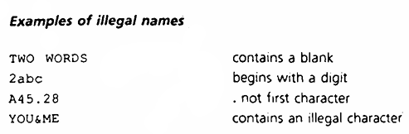
Name Field

Slide 8
Operation Field
Operation's function:
MOV
ADD
SUB

Slide 9
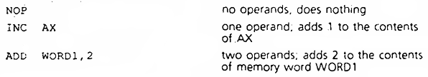
Operand Field
Operand field specifies the data that are to be acted on by
the operation.

Slide 10
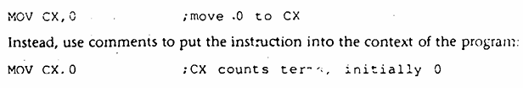
Comment Field
The comment field of a statement is used by the programmer to say something about what the statement does.
A semicolon marks the beginning of this field, and the assembler ignores anything typed after the semicolon.
Comments are optional but assembly language is so low-level, it is almost impossible to understand an assembly language program without comments.

Slide 11
Program Data
The processor operates only on binary data. The assembler must translate all data representation into binary numbers.
An assembly language program we may express data as binary, decimal, or hex numbers, and even as characters.

Slide 12
Program Data
Numbers:
A binary number is written as a bit string followed by the letter “B" or "b“. For example: 1010B.
A decimal number is a string of decimal digits, ending with an optional "D" or "d".
A hex number must begin with a decimal digit and end with the letter "H" or "h“. For example: 0ABCH.

Slide 13
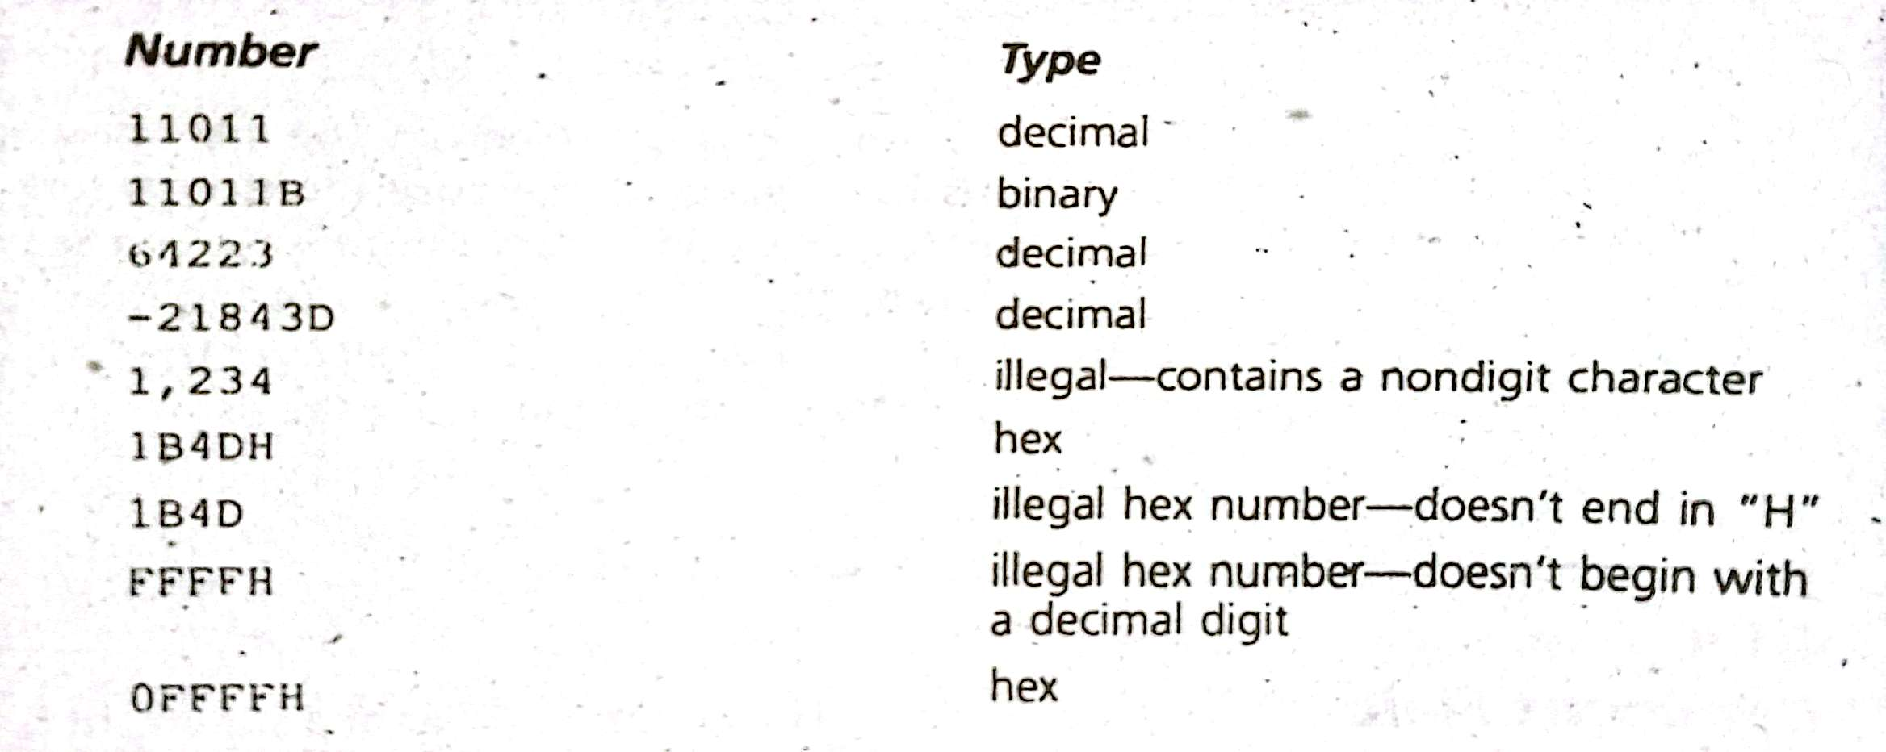
Program Data

Slide 14
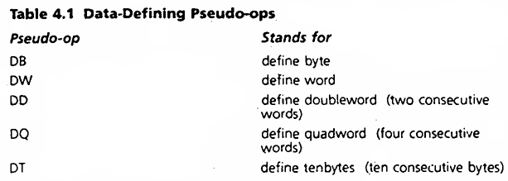
Program Data
Characters:
Characters and character strings must be enclosed in single or double quotes. For example: "A" or 'hello'.

Slide 15
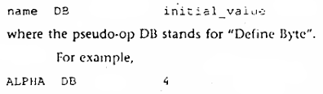
Variable and Byte Variable
Variable:
Variables play the same role in assembly language that they do in high-level languages.
Each variable has a data type and is assigned a memory address by the program.
Byte Variable
Byte variable takes the following form:

Slide 16
Variable and Byte Variable
Byte Variable
Byte variable is defined in the following form:
Here,
name: ALPHA.
initialial_value: 4.

Slide 17

Variable and Byte Variable
Byte Variable
A question mark (" ?") used in place of an initial
value sets aside an uninitialized byte. For example:

Slide 18


Word Variable
Word variable is defined in the following form:
Here,
name: WRD.
initialial_value: -2.

Slide 19
Arrays
In assembly language, an array is just a sequence of memory bytes or words.
For example:
To define a three-byte array called B_ARRAY, whose
initial values are 10h, 20h, and 30h. We can write,

Slide 20
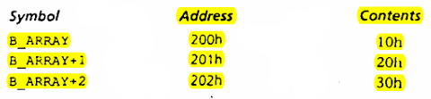
Arrays
The name B_ARRAY is associated with the first of these bytes, B_ARRAY+1 with the second, and B_ARRAY+2 with the third. If the assembler assigns the offset address 0200h to B_ARRAY, then memory would look like this:

Slide 21
Arrays
The name B_ARRAY is associated with the first of these bytes, B_ARRAY+1 with the second, and B_ARRAY+2 with the third. If the assembler assigns the offset address 0200h to B_ARRAY, then memory would look like this:
In the same way, an array of words may be defined. For example,

Slide 22

Arrays
Character Strings:
Inside a string, the assembler differentiates between upper and lower case. Thus, the string "abc" is translated into three bytes with values 61h, 62h, and 63h.

Slide 23
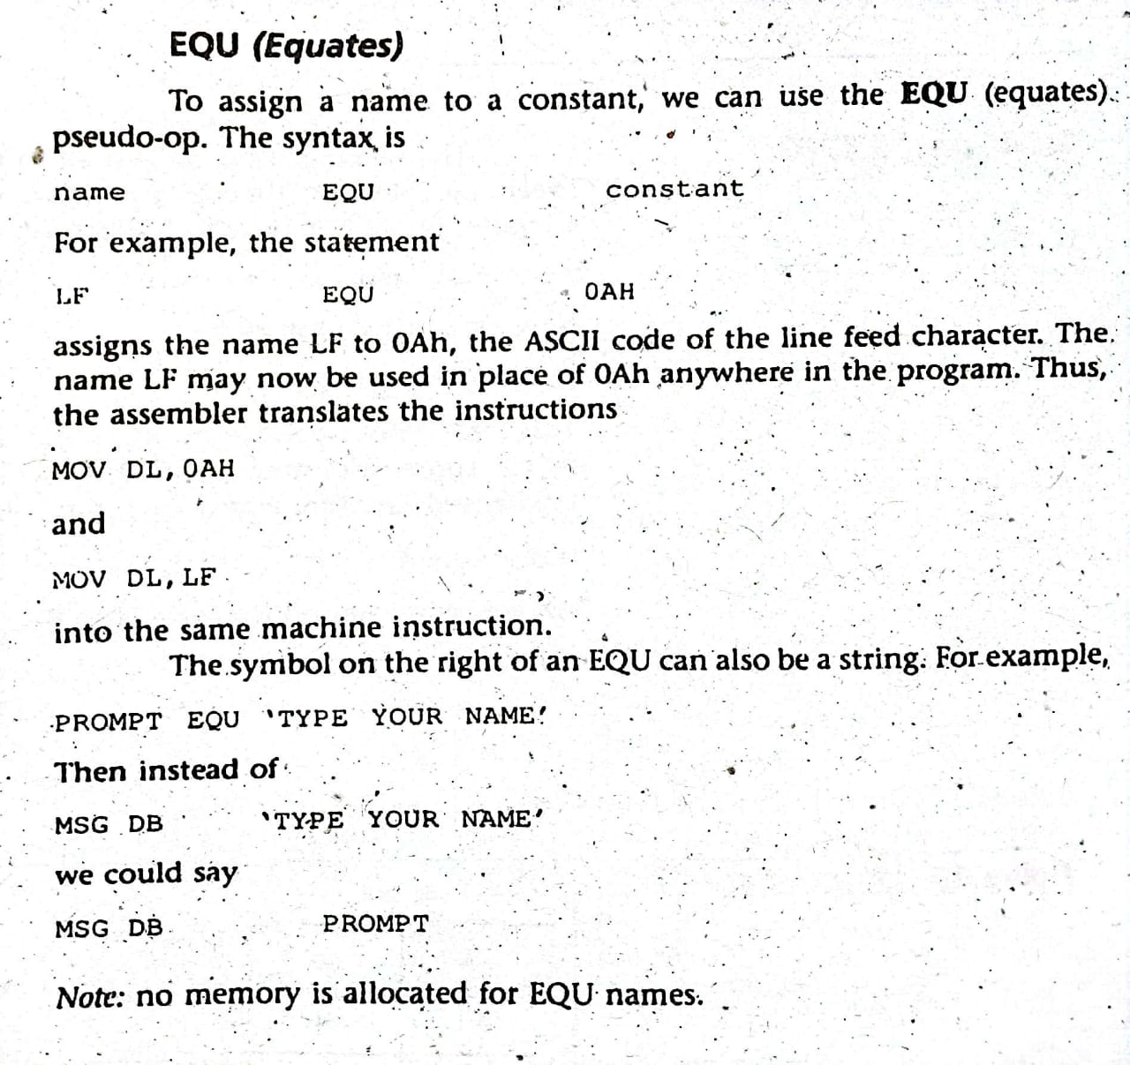
Named Constants

Slide 24


A Few Basic Instructions
MOV and XCHG:
The MOV Instruction is used to transfer data between registers, between a register and a memory location, or to move a number directly into a register or memory location. The syntax is,
Example:
The contents of register AX are replaced by the contents of memory location WORD1. The contents of WORD1 are unchanged.

Slide 25
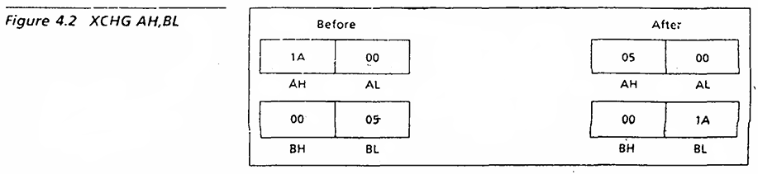
A Few Basic Instructions
MOV and XCHG:
MOV AX, BX
AX gets what was previously in BX. But BX is unchanged.

Slide 26
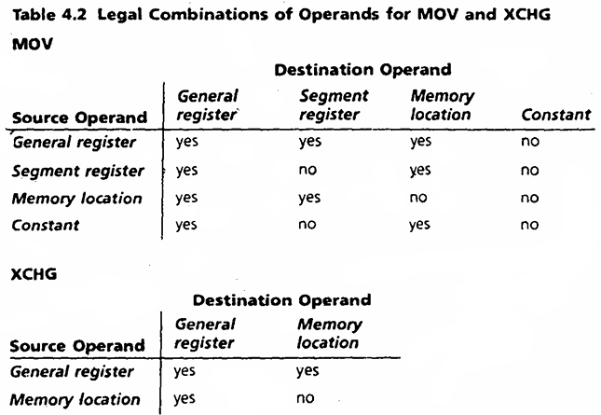
A Few Basic Instructions
MOV and XCHG:

Slide 27

A Few Basic Instructions
MOV and XCHG:
XCHG (exchange) operation is used to exchange the contents
of two registers, or a register and a memory location. The syntax is,
This instruction swaps the contents of AH and BL, so that AH contains what was previously in BL and BL contains what was originally in AH.

Slide 28

A Few Basic Instructions
MOV and XCHG:
Another example is,
Swaps the contents of AX and memory location WORD1.

Slide 29

A Few Basic Instructions
Restrictions on MOV and XCHG:
There are a few restrictions on the use of MOV and XCHG.
MOV or XCHG between memory locations is not allowed. For example,
Solution:
We can solve this restriction by using a register.

Slide 30
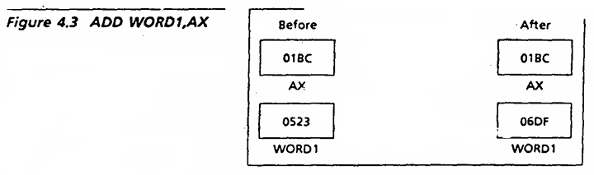
A Few Basic Instructions

Slide 31


A Few Basic Instructions
ADD, SUB, INC, DEC:
ADD and SUB instructions are used to add or subtract the contents of two registers, a register and a memory location. The syntax is,
Example:
i)
This instruction, "Add AX to WORD1" causes the contents of AX and memory word WORD1 to be added, and the sum is stored in WORD1. AX is unchanged.

Slide 32

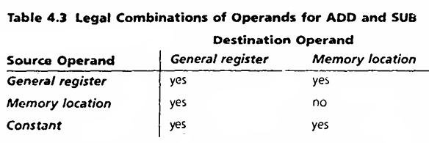
A Few Basic Instructions
ADD, SUB, INC, DEC:
Example:
ii)
This instruction, "Subtract DX from AX" the value of DX is subtracted from the value of AX, with the difference being stored in AX. DX is unchanged.

Slide 33
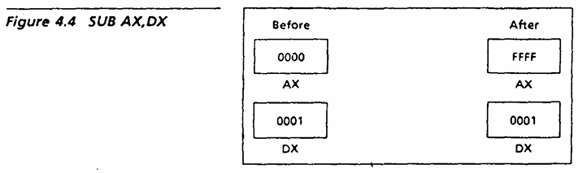
A Few Basic Instructions
ADD, SUB, INC, DEC:

Slide 34

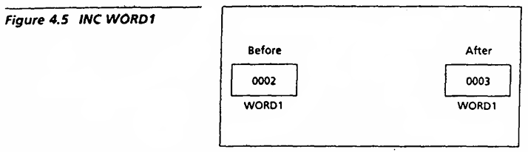
A Few Basic Instructions
ADD, SUB, INC, DEC:
INC (increment) is used to add 1 to the contents of a register or memory location. The syntax is,
Example:

Slide 35

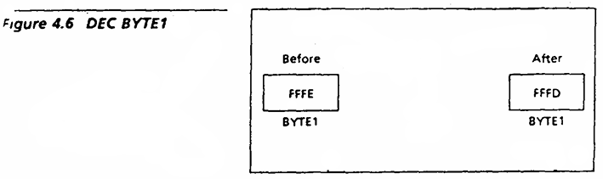
A Few Basic Instructions
ADD, SUB, INC, DEC:
DEC (decrement) is used to subtract 1 from a register or memory location. The syntax is,
Example:

Slide 36

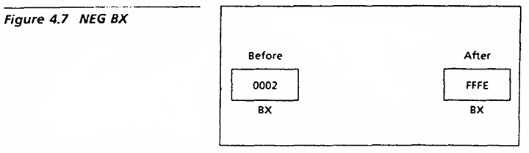
A Few Basic Instructions
ADD, SUB, INC, DEC:
NEG is used to negate the contents of the destination. NEG does this by replacing the contents by its two's complement. The syntax is,
Example:
Negates the contents of BX.

Slide 37
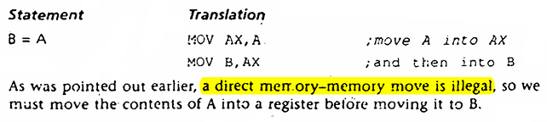
Translation of High Level Language to Assembly Language

Slide 38
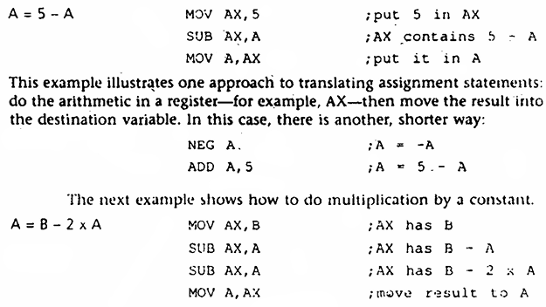
Translation of High Level Language to Assembly Language

Slide 39
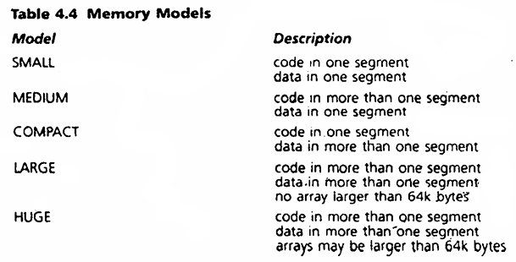
Memory Models
The size of code and data a program can have is determined by specifying a memory model using the .MODEL directive. The syntax is,

Slide 40
Input and Output Instructions
There are two ways to do input and output on the IBM PC:
By direct communication with I/O devices.
By using BIOS or DOS routines.
BIOS (Basic Input Output System) routine: Stored in ROM and interact directly with the I/O ports.
DOS routine: Carry out more complex tasks. For example: Printing a character string.
CPU communicates with the peripherals through I/O registers called I/O ports.

Slide 41
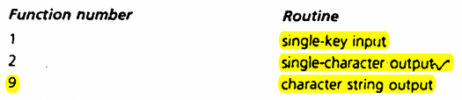
Input and Output Instructions

Slide 42
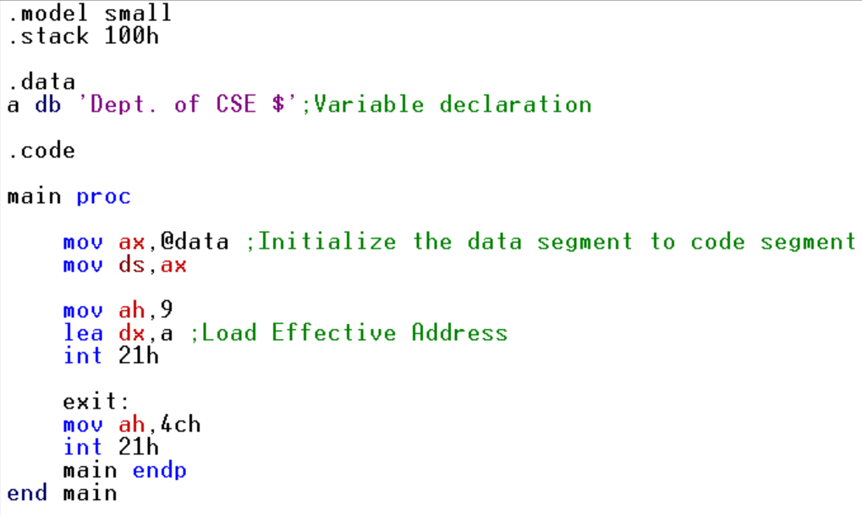
A Program for Displaying String

Slide 43
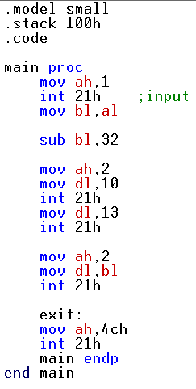
A Program for Case Conversion
Lowercase to Uppercase:

Slide 44
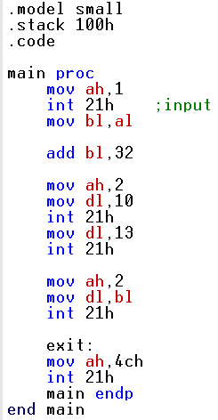
A Program for Case Conversion
Uppercase case to Lowercase:

